Slide 1
High and Low
Rice Cultures 2017
Seminar 6

Slide 2
Last week, we drew ecological models of sawah (wet-rice) and swidden (dry rice), based on Clifford Geertz’s analysis.
We discussed how Dutch colonial politics intersected with these ecosystems in different ways.

Slide 3
State space
”You are free to conjure up an ecology, a demography, and a geography that would be most favorable to the state and its ruler. What, in those circumstances, would you design?”

Slide 4
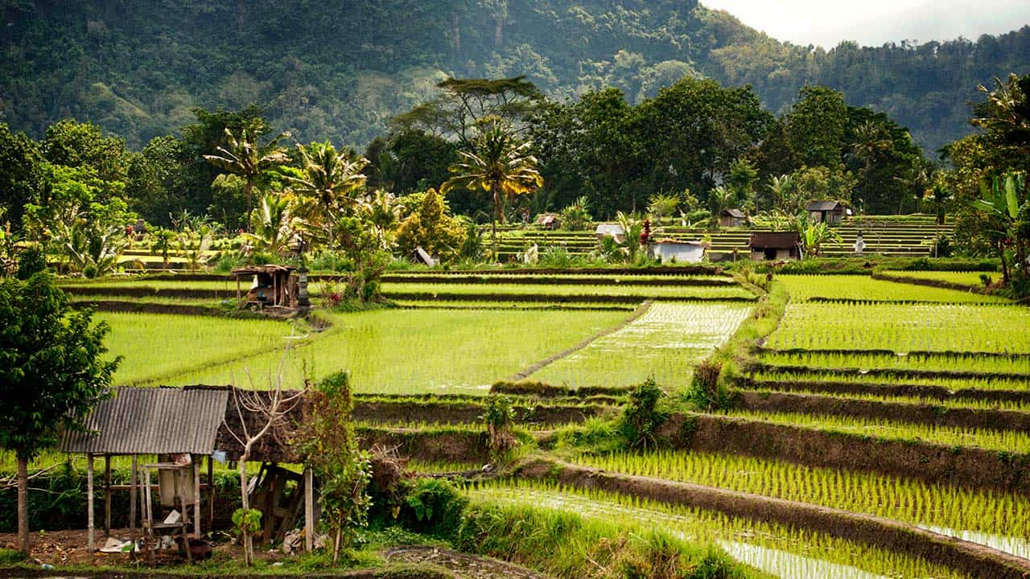
Irrigated wet rice

Slide 5
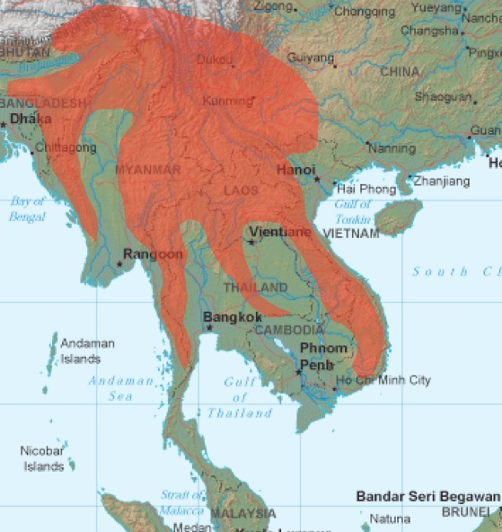
Zomia

Slide 6
Friction of Distance Map
Pick any section of Southeast Asia, using Google maps.
Draw a map that displays the friction of distance, rather than ‘as the crow flies’. (see map on p. 46 as one model—or develep your own method of representation)
Use this topographic map to get altitude data:
en-gb.topographic-map.com/

Slide 7
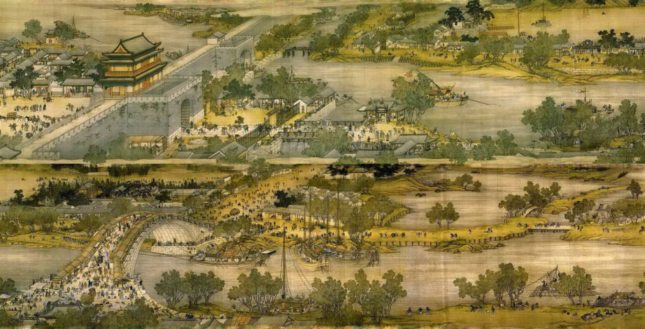
Rethinking the history of civilization

Slide 8
“Our living ancestors”
Small minority groups at the margins
Civilizing process: progressive incorporation of ‘backward’ peoples
Those who remain at the margins of state are more ‘primitive’, stand for the ‘past’

Slide 9
From the State’s Point of View
Primitive
Civilized
TIME
Swidden
Paddy
Center
Concentration of manpower and grain
Swidden
Margins
SPACE

Slide 10
How does Scott challenge the State-centered perspective?

Slide 11
The ’state’ is a real minority among human systems
Homo sapiens sapiens: 200,000 BP
Domestication: 10,000 BP
States: 2,000 BP

Slide 12
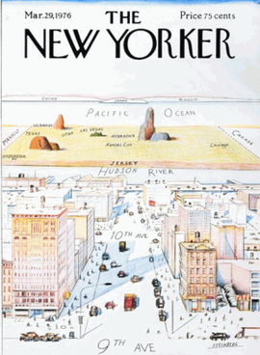

Slide 13
Contemporary consensus
Many peoples fled to the margins
History of interchanges and mutual co-development between lowlands and highlands
The small minority groups are not left behind by social evolution: they chose to leave

Slide 14
Orang asli
Once thought to be descendants of an earlier wave of migration—the “original people”
Tribality is actually a political opposition to peasant ways of life: understood as a system of cultivation incorporated into the state (Scott, 183)
“Many [Malay] tribal populations have been living in geographically remote regions out of choice, as part of a strategy to keep the state off their backs.”--Geoffrey Benjamin (NTU)

Slide 15
Why does swidden farming create a ‘non-state’ space?

Slide 16
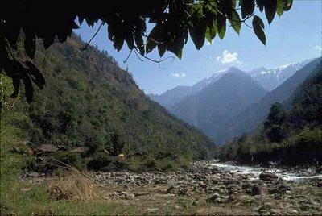
Location: inaccessibility
Mobility
Kachin Hills, Myannmar

Slide 17
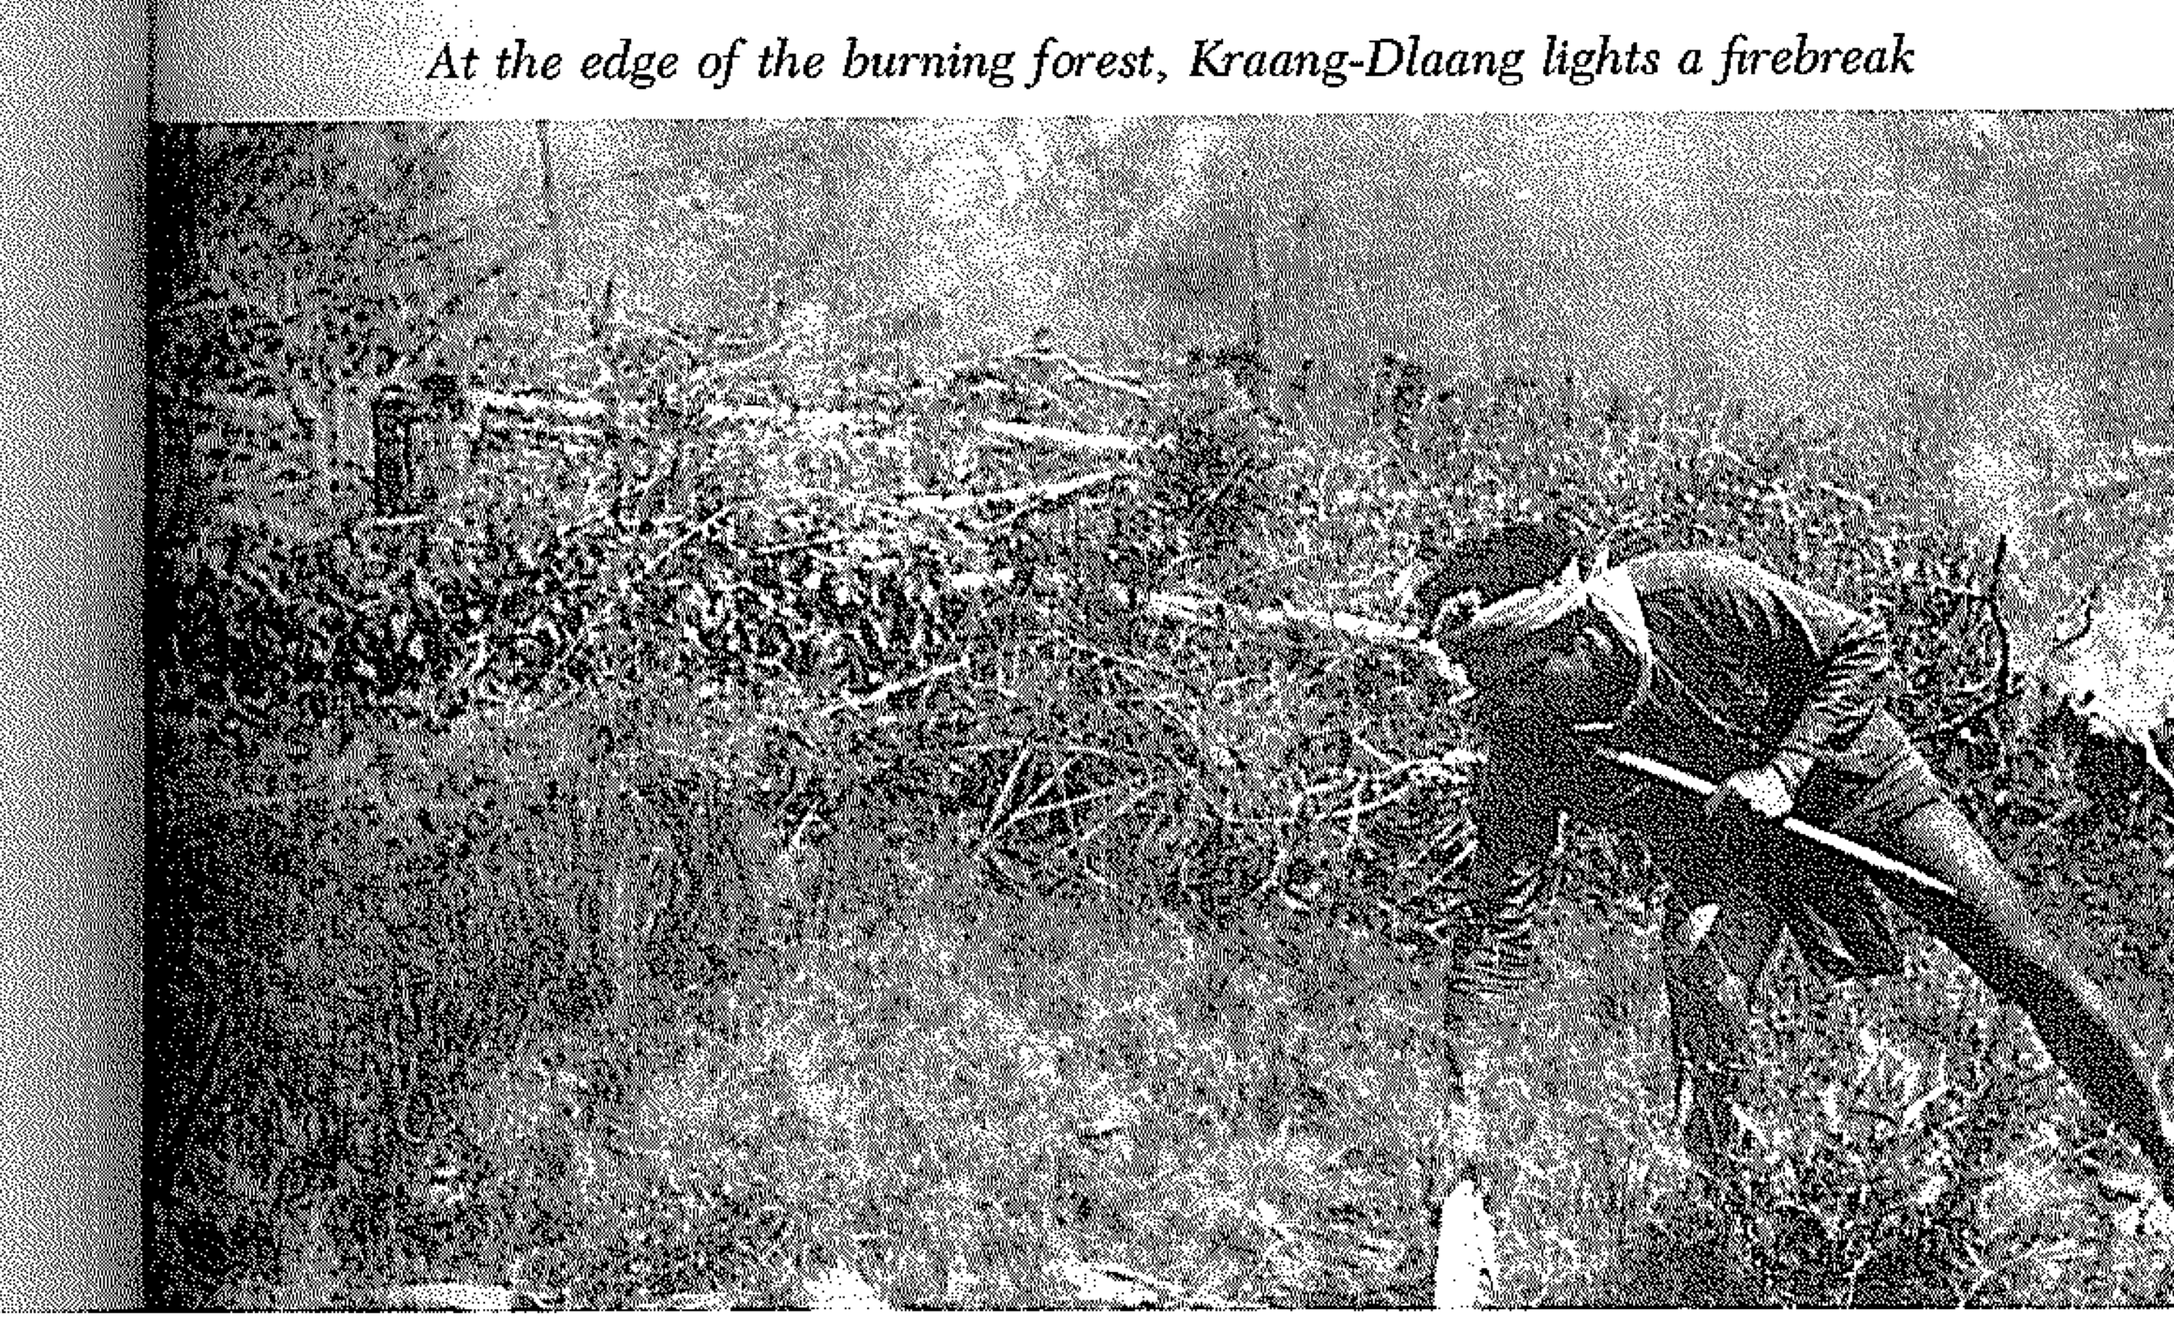
“Until quite recently, many societies and groups have abandoned fixed cultivation to take up shifting agriculture and foraging” (188-189)

Slide 18
“Shifting cultivation was a fiscally sterile form of agriculture: diverse, dispersed, hard to monitor, hard to tax or confiscate.” (191)
“Swiddeners were themselves dispersed, hard to monitor, hard to collect for corvee labor or conscription” (191).

Slide 19
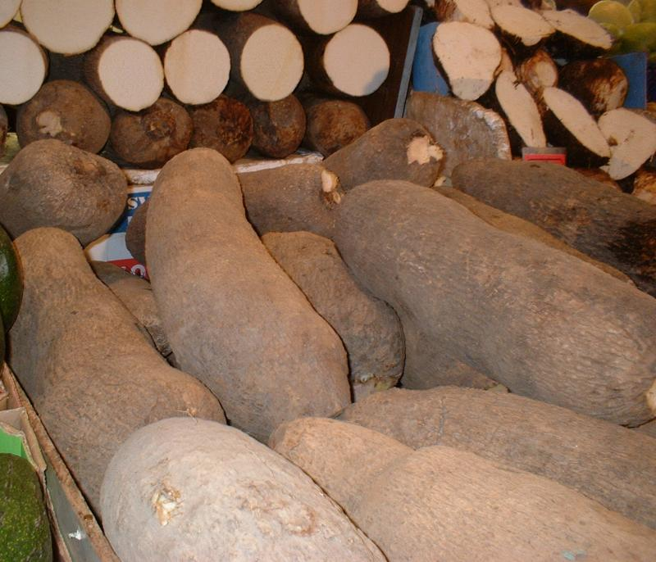
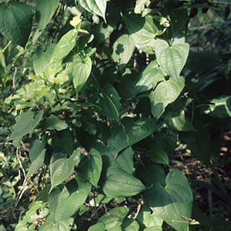
“Escape crops”

Slide 20
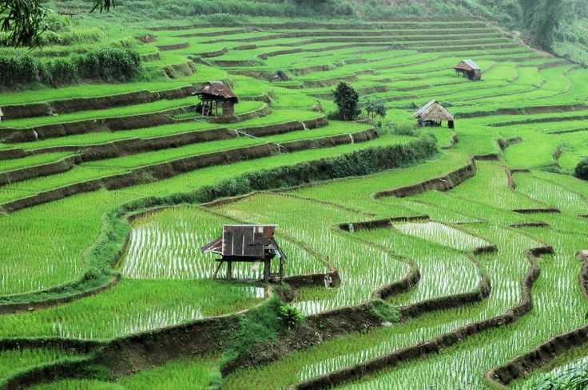
Compared with . . .

Slide 21
The end of non-state space?
Due to Global Poistioning Systems, satellite remote sensing of Earth, drones, all-weather roads, mobile telephones, and other technologies, Zomia no longer provides a geographic escape from the state.
Where can today’s non-state space be found?
How would you “design” a non-state space?

